Slide 1
Operators
An operator is represents an operations that may be performed on one or more operands
Ex: 2+5, here 2 and 5 is operant and + is operator
Types:
Unary operator
Arithmetic operator
Shift operator
Relational operator
Logical operator
Bitwise operator
Assignment operator. 8. Ternary operator

Slide 2
1. Unary operator
The Java unary operators require only one operand.
Unary operators are used to perform various operations
Incrementing/decrementing a value by one
Not Operator.

Slide 3
Incrementing/decrementing a value by one
In Java, increment and decrement operators are used to increase or decrease the value of a variable by 1, respectively. These operators are very commonly used in loops.
Increment Operators
Decrement Operators
Post-Increment Operator( i++)
Pre-Increment Operator (++i)
Post-Decrement Operator (i--)
Pre-Decrement Operator (--i)

Slide 4
Example :
public class hel {
public static void main(String args[]) { int x = 10;
System.out.println(x++); System.out.println(++x); System.out.println(x--); System.out.println(--x);
}
}

Slide 5
Arithmetic Operators
Java arithmetic operators are used to perform addition, subtraction, multiplication, and division.
They act as basic mathematical operations.

Slide 6
public class Arithmetic {
public static void main(String[] args) { int a = 10;
int b = 5; System.out.println(a + b); System.out.println(a - b); System.out.println(a * b); System.out.println(a / b); System.out.println(a % b);
}
}

Slide 7
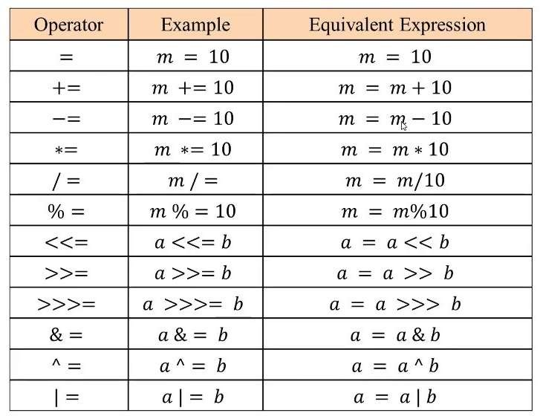
Assignment operator:
Assignment operators are used in Java to assign values to variables.

Slide 8
public class Assignment {
public static void main(String[] args) { int x = 5;
int y = 10; int z = x; x += y;
y -= x;
z *= y; x /= 2;
System.out.println(x); System.out.println(y); System.out.println(z);
}
}jdfdf

Slide 9
Relational operator
Relational operators are used to check the relationship between two operands.
Relational operators compares the values. It either returns True or False according to the condition.
jdfdf

Slide 10
public class Relational {
public static void main(String[] args) { int a = 7, b = 11; System.out.println(a == b); System.out.println(a != b); System.out.println(a > b); System.out.println(a < b); System.out.println(a >= b); System.out.println(a <= b);
}
jdfdf}

Slide 11
Logical Operators
Logical operators are used to check whether an expression is true or false.
They are used in decision making.
Logical || ,Bitwise | operator
The logical || operator doesn't check the second condition if the first condition is true.
It checks the second condition only if the first one is false.
The bitwise | operator always checks both conditions whether first condition is true or false.
jdfdf

Slide 12
Logical operators
These operators are used to deal with logical operations.
Name | Operator | Example
AND | && | a && b
OR | || | a || b
NOT | ! | ! (a=2 or b=3)

Slide 13
public class Logical {
public static void main(String[] args) {
// && operator
System.out.println((5 > 3) && (8 > 5)); // true
System.out.println((5 > 3) && (8 < 5)); // false
// || operator
System.out.println((5 < 3) || (8 > 5)); // true
System.out.println((5 > 3) || (8 < 5)); // true
System.out.println((5 < 3) || (8 < 5)); // false
// ! operator
System.out.println(!(5 == 3)); // true
System.out.println(!(5 > 3)); // false
&& and || and !
}
jdfdf
}

Slide 14
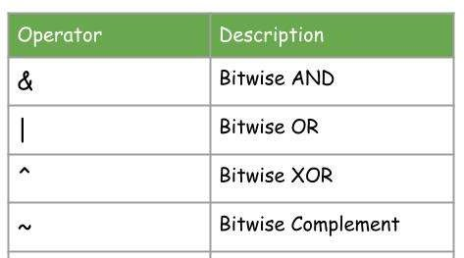
Bitwise operators
Bitwise operators are used to deal with binary operations.

Slide 15
Example :
// Bitwise AND operator & |  | 8421 | //Bitwise OR | operator | 8421
int a = 10 ; |  | // 00001010 | int a = 10 ; | // 00001010
int b= 8; |  | // 00001000 | int b= 8; | // 00001000
System.out.println(a&b); |  | // 00001000 | System.out.println(a|b); | // 00001010
//Bitwise XOR ^ | 8421
int a = 10 ; | // 00001010 Sets bit to 1 if bits are different (i.e., 1 ^ 0 or 0 ^ 1), else 0.
int b= 8; | // 00001000
System.out.println(a^b); | // 00000010
//Bitwise Complement int a = 10; System.out.println(~a);
8421
// 00001010
// 11110101 => one's complement
// 00001010 => 10
// +1 => add one to the original bit if the LMB is 1
// 00001011 => -11

Slide 16
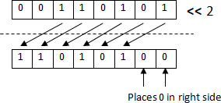
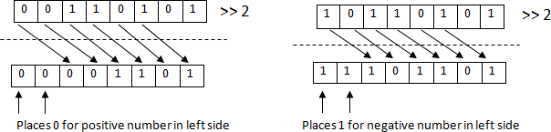
Shift operator
Left shift operator <<
Right Shift operator >>

Slide 17
Difference between >> and >>>
Operator | Effect
>> (Signed Right Shift) | Preserves the sign bit (fills leftmost bits with 1 if negative, 0 if positive).
>>> (Unsigned Right Shift) | Always fills leftmost bits with 0, ignoring the sign.

Slide 18
public class Shift {
public static void main(String[] args) { System.out.println(10<<2); System.out.println(10>>2);
}
}

Slide 19
Ternary operator
In Java, the ternary operator, also known as the conditional operator, is a
shorthand version of an if-else statement.
It is unique because it takes three operands:
A condition followed by a question mark (?)
A value if the condition is true
A value if the condition is false.
Syntax:
condition ? valueIfTrue : valueIfFalse
jdfdf

Slide 20
package btec;
public class Ternary {
public static void main(String[] args) { int x = 5;
int y = 10;
int result;
// Using ternary operator to find the maximum of two numbers
result = (x > y) ? x : y;
System.out.println("The maximum value is: " + result);
}
jdfdf
}

Slide 21
Operator precedence and use of parenthesis
Operator precedence determines the order in which operators are evaluated in an expression.
Example:
In the expression 5 + 3 * 2, the multiplication (*) happens before addition (+) due to higher precedence.

Slide 22
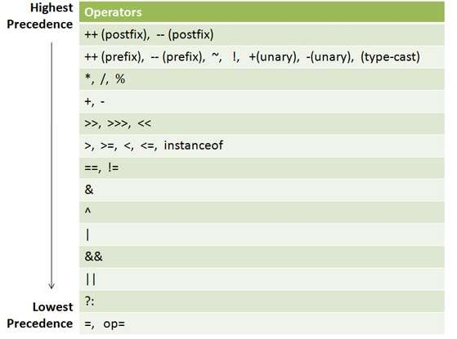

Slide 23
Operator Precedence Order
Highest to Lowest Precedence:
Parentheses ()
Postfix Operators: x++, x--
Unary Operators: ++x, --x, +, -, !
Multiplication, Division, Modulus: *, /, %
Addition, Subtraction: +, -
Relational Operators: <, >, <=, >=, ==, !=
Logical AND &&
Logical OR ||
Ternary Conditional Operator: condition ? expr1 : expr2
Assignment Operators: =, +=, -=, *=, /=

Slide 24
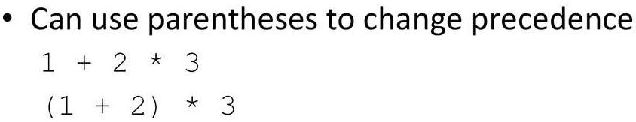
Parentheses ( )
Parentheses () are used to:
Change the order of operations.
Group expressions for clarity.
Example:
int result = (5 + 3) * 2;
// Forces addition to happen before multiplication

Slide 25
